Slide 1

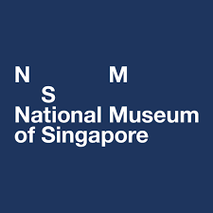
Front cover
Photo Essay
UCV2207 Politics of Heritage

Slide 2
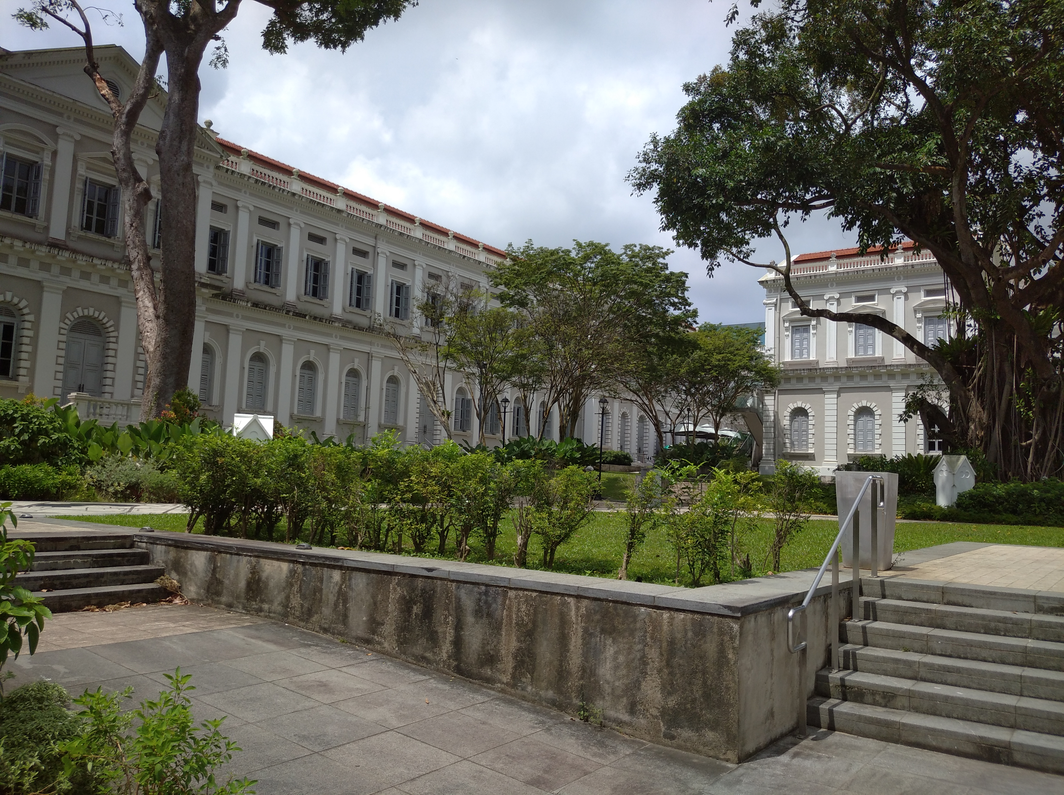
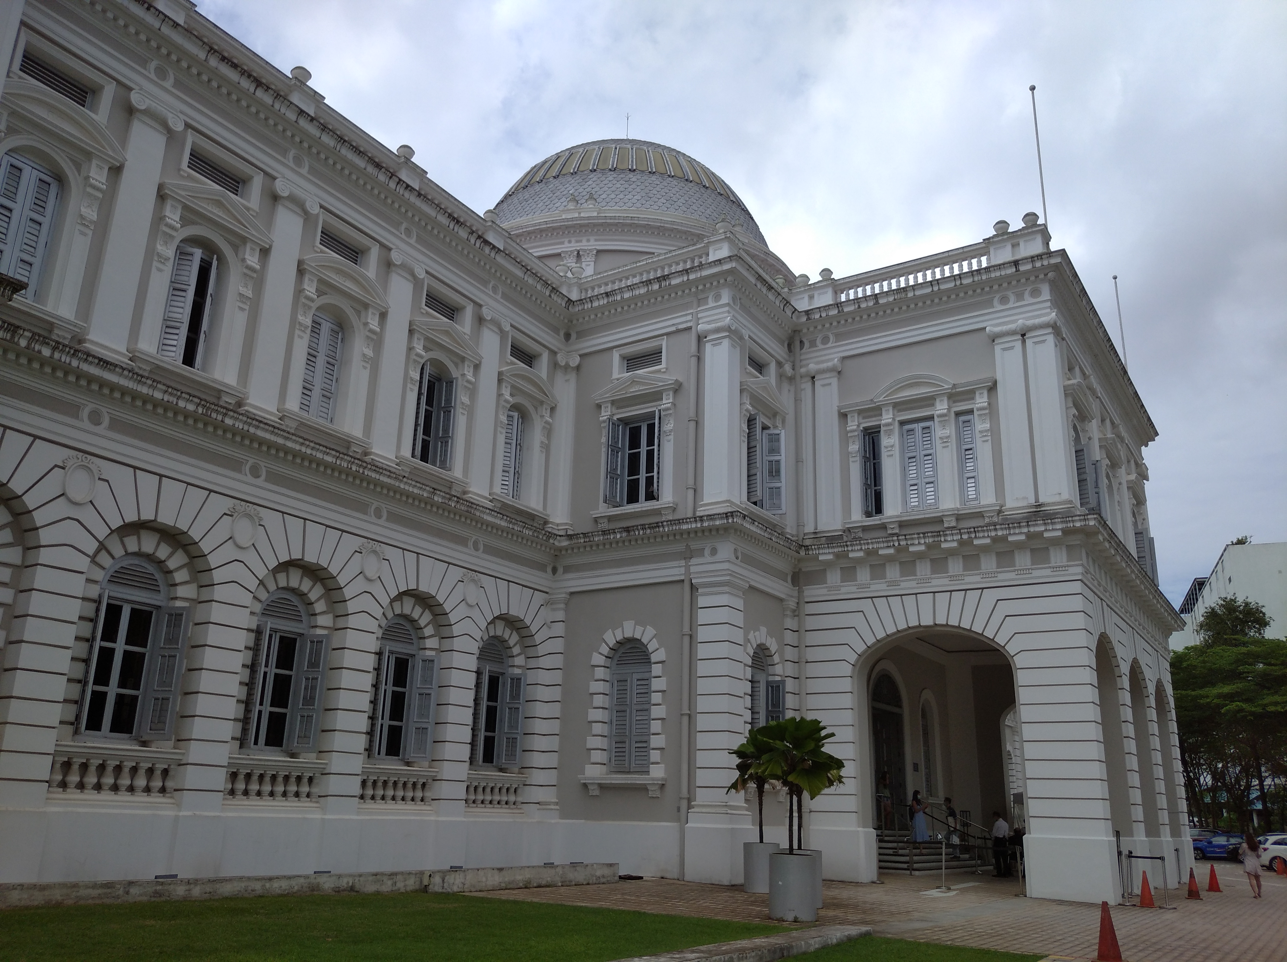
What’s my heritage?
1
As someone who could not put a finger on his heritage, I made a trip to the National Museum of Singapore (NMS). Among the institutions administered by the National Heritage Board, the NMS focuses most on the collective history of Singapore. I decided that the NMS would give me the most complete picture of my heritage as a Singaporean.
In total, I visited three exhibitions. The first was a mega-gallery that charted Singapore’s history in broad strokes from the 1200s to the present; the second was a showcase of Singaporean artistry in post-independence Singapore, and the third was an immersive exhibition about contemporary Singaporean history.
In this essay, I want to bring the reader on the tour that I embarked on, sifting through our history to figure out our heritage.
Leong Jia Hao, Timothy
Singapore’s leaders have issued calls for national solidarity amidst the Covid-19 pandemic. What does it mean for Singapore to be one nation? According to Benedict Anderson, its people must imagine themselves as having a differentiated identity (Anderson 1983).
And much of that identity stems from a nation’s heritage, says Lily Kong. Heritage has an “integral role in a people’s search for cultural and social identification” (Kong 1999). Heritage helps people to understand how the past shaped the present, and where they are in the nation’s narrative, which gives them a sense of belonging (Yeoh and Kong 1996).

Slide 3
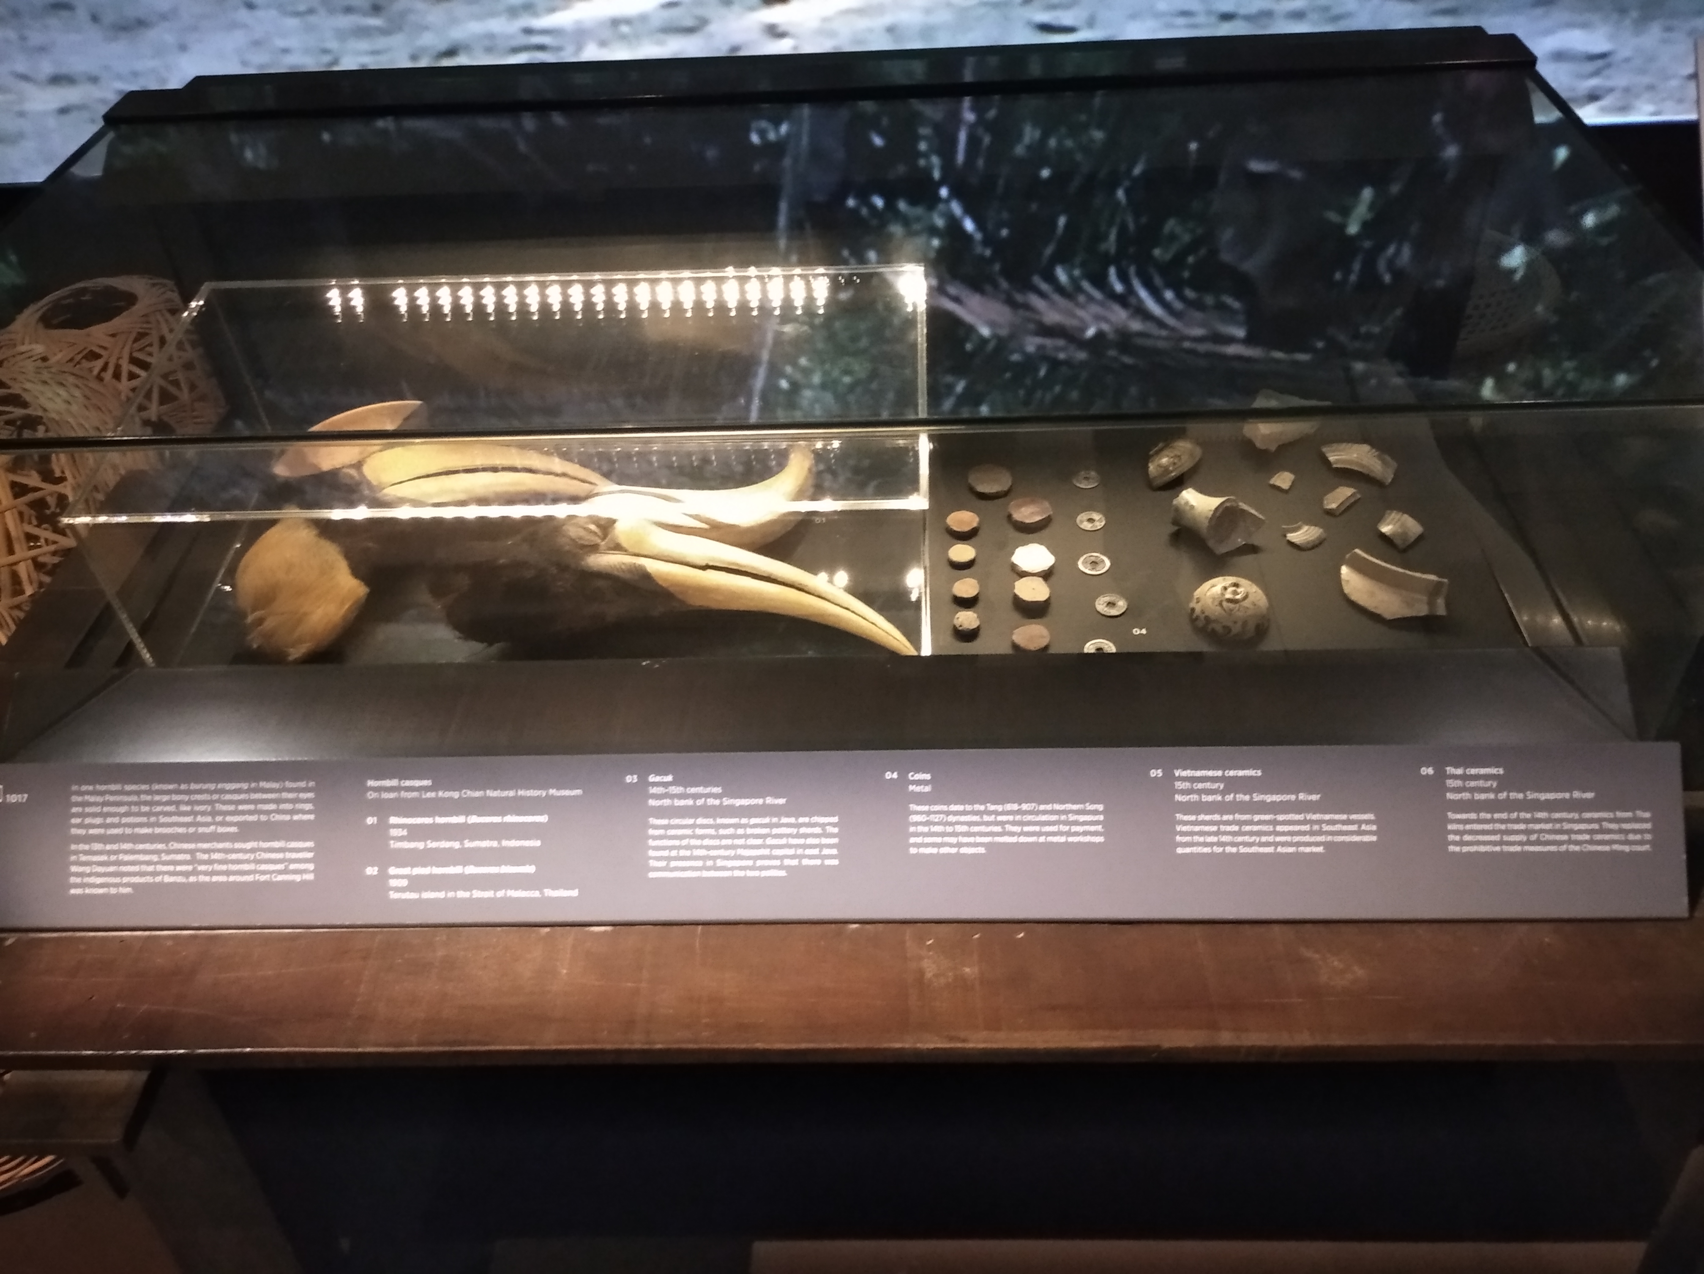
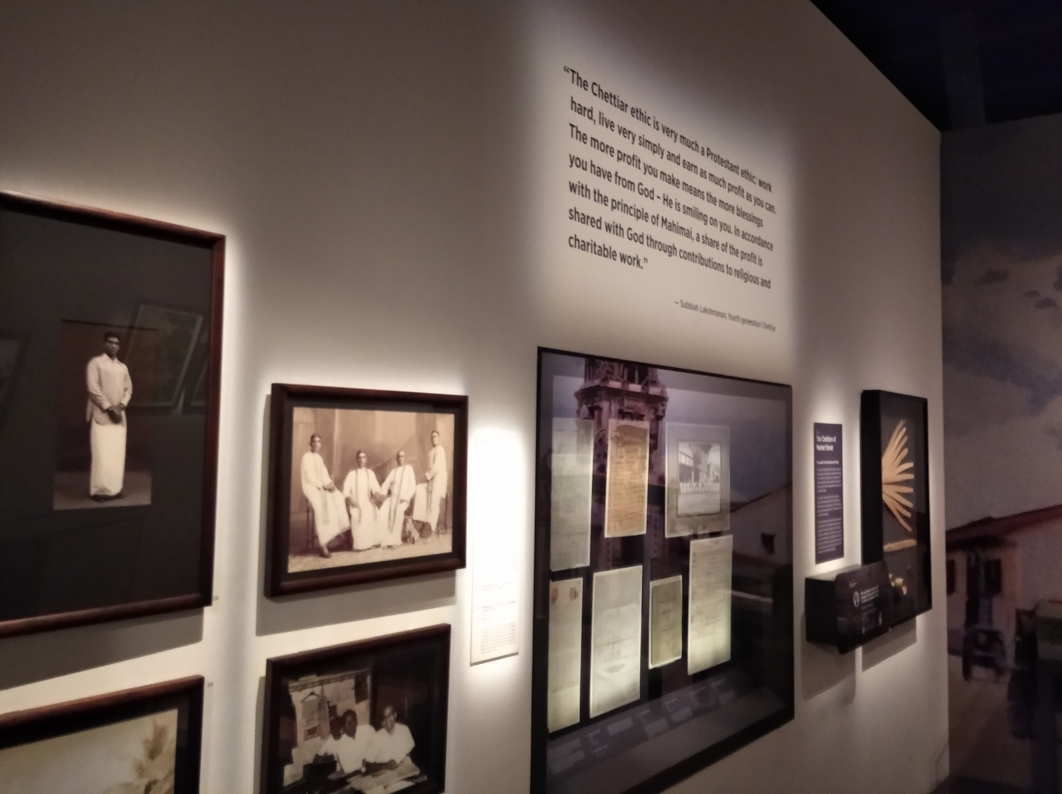
Singapore History Gallery
1
Crown Colony (1819-1941)
In this section, Singapore is presented as a cluster of ethnic enclaves with no overall communal identity yet. We peek into the lives of various colonial administrators and ethnic community leaders.
If you are a member of one of these ethnic communities, perhaps the stories of your community may be relevant for you. But these stories could never constitute a “national narrative” for all “Singaporeans”.
Exhibition 1
We begin our journey in the Singapore History Gallery. As its name suggests, this exhibition concerns itself with the facts of Singapore’s past.
Singapura (1299-1818)
In this first section, we are greeted with elaborate displays of artifacts from this period. At this stage in history, Singapura was mostly a pre-industrial commercial hub for traders around the world so there is no narrative here about nation-building.
Given the lack of cultural legacies from this period that have survived until today, it is hard to derive “a shared understanding and a sense of belonging” (Kong 1999) from this period. Since Singaporeans today share nothing with this past, this period of history cannot translate into our heritage.

Slide 4
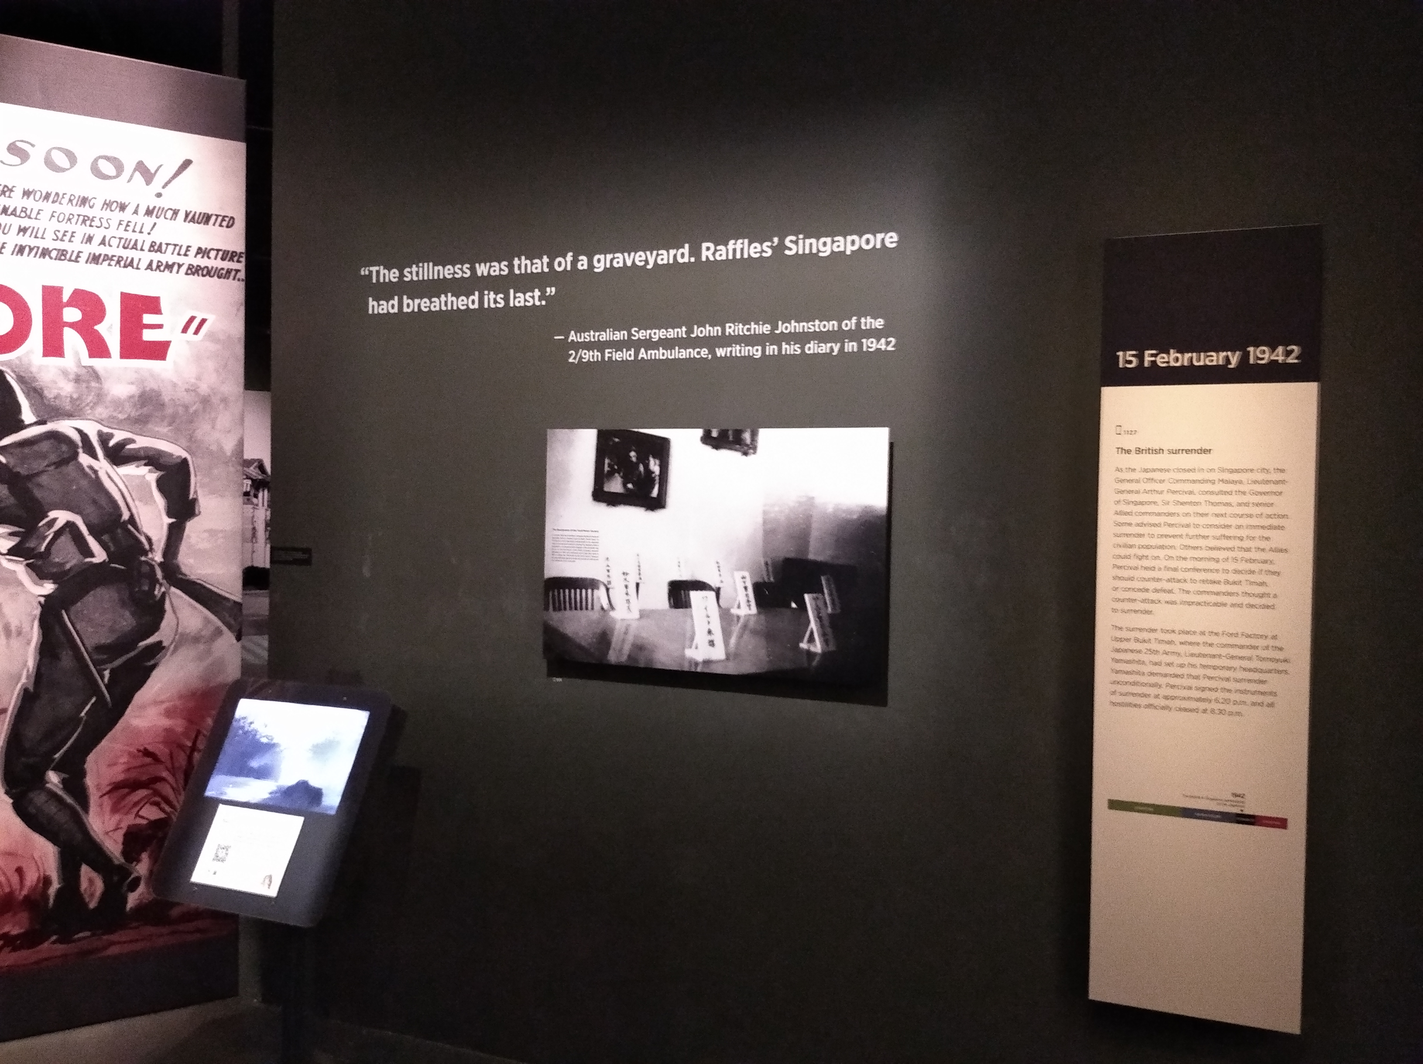
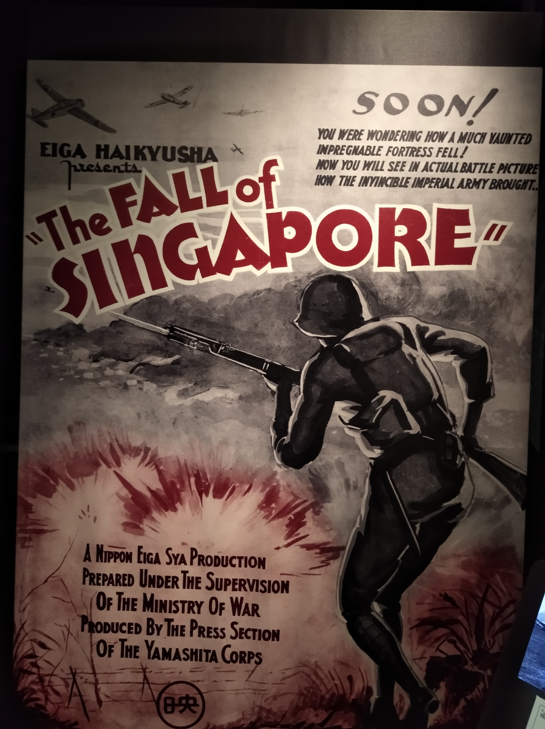
Syonan-to (1942-1945)
As Lily Kong points out about Operation Coldstore, “it is… entirely possible for young Singaporeans to have a collective memory of the struggle against communism in Singapore without feeling that it is their heritage, and without it contributing to a sense of belonging to Singapore” (Kong 1999).
Thus, while WWII is part of our collective memory, it is not part of our heritage. Heritage needs to be “a living reality” for its beholder (Kong 1999), and Singapore has done much to forget the pain of war.
WWII is a part of the collective national memory of Singaporeans since every year we have Total Defence Day to commemorate it. But Singapore does not place value on its wartime struggles in the way that Israel might (Fisher 2018). If it did, these memories would only become increasingly weightless with each generation that lived in peacetime. After all, says Madame de Staël, “we understand death only after it has placed its hands on someone we love”. An identity anchored on weightless memories would be easily unmoored.

Slide 5
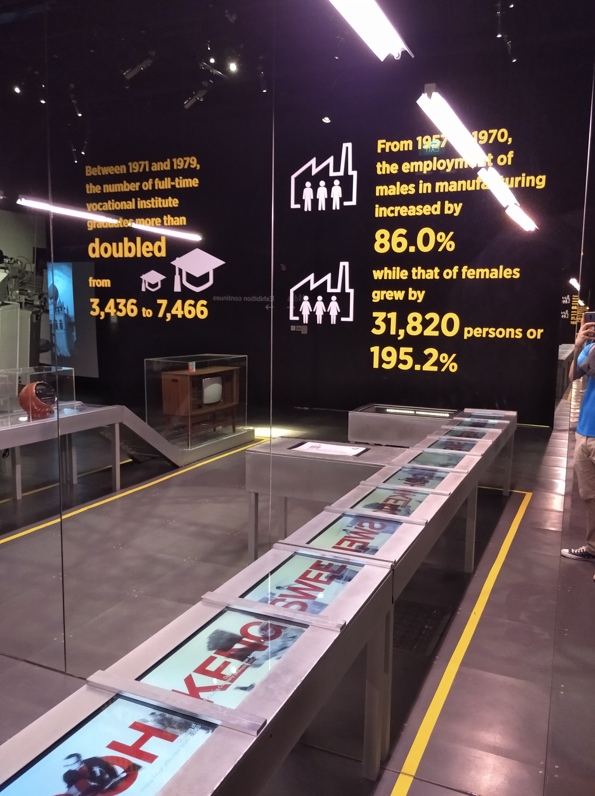
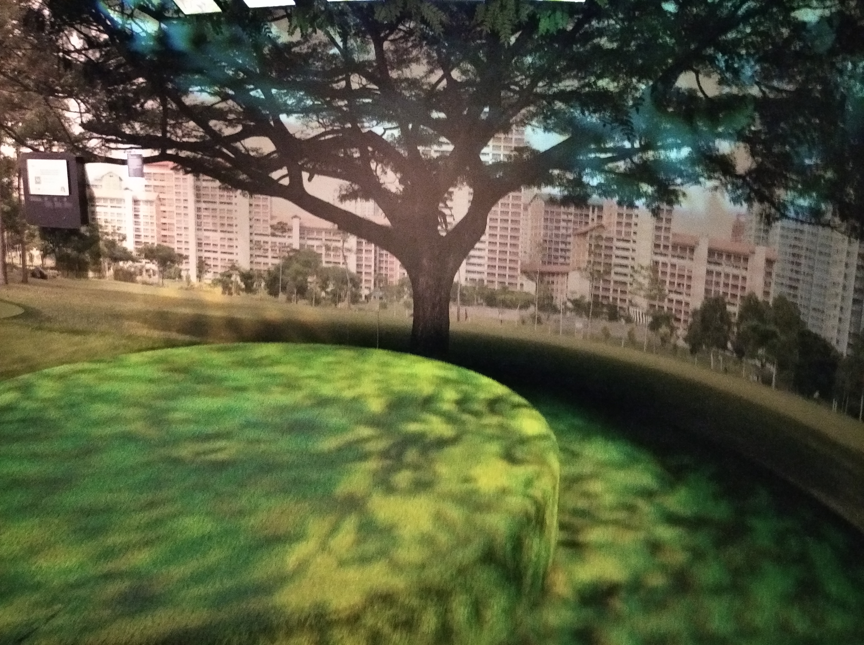
Singapore (1945 - Present)
Overall thoughts about The Singapore History Gallery
This gallery makes an excellent resource for learning the history of Singapore.
However, as an instrument for transmitting a sense of heritage, it fails in one important aspect which is making the past “provide a sense of belonging and identity” for Singaporeans (Kong, 1999).
David Lowenthal puts it best when he says: “History and heritage transmit different things to different audiences. History tells all who will listen what has happened and how things came to be as they are. Heritage passes on exclusive myths of origin and continuance, endowing a select group with prestige and common purpose.” (Lowenthal 1997).
Living up to the criticism that Singapore has always had a narrow mind for economic development, this section barrages the viewer with statistics about the rapid modernisation of our landscape.
Although our high standards of living are celebration worthy, there is very little narrative here about how we arrived in the present as a nation because the exhibits focus solely on the policy decisions of the government, as if the people were backseat participants in their nationhood.

Slide 6
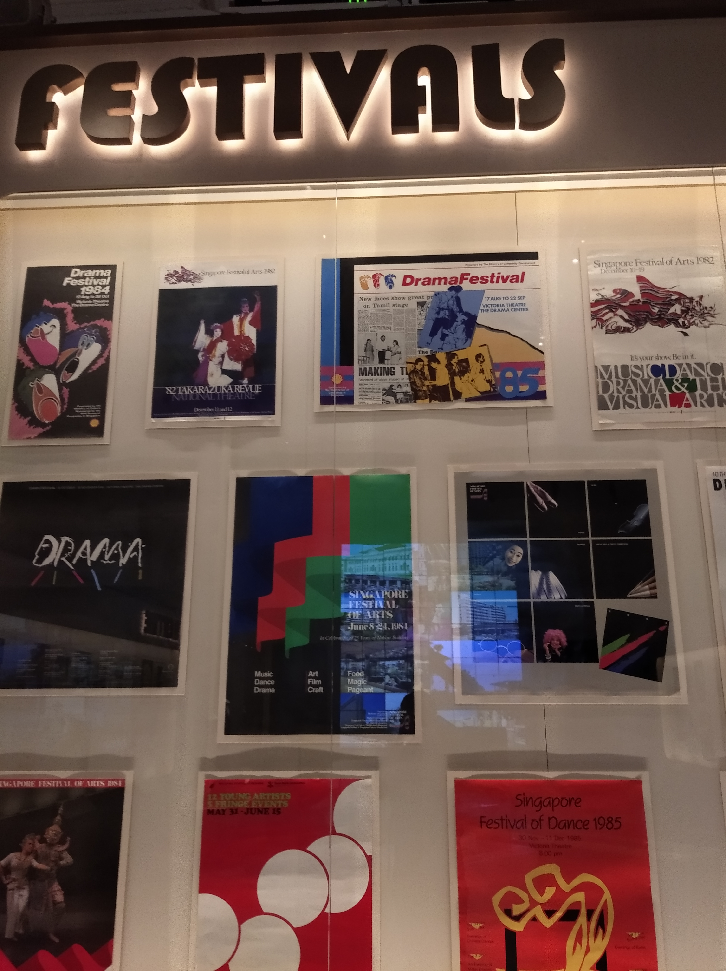
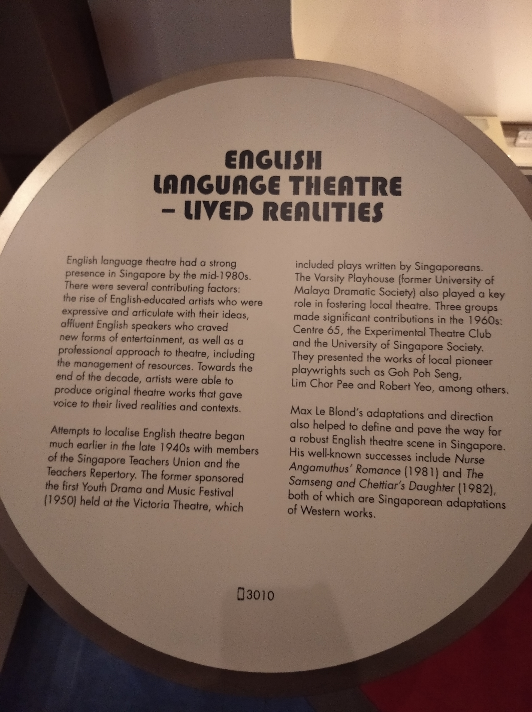
Voices of Singapore
2
Exhibition 2
Voices of Singapore tells the story of how local artists wrote performance pieces which blended the vernaculars and cultural experiences of different races together.
Unlike the history gallery from earlier, this exhibition gives us a narrative of how national identity arose organically from the “ground up” through the self-expressions of artists. Could our artistic history form part of our heritage? Although it is tempting to think so, there are two immediate problems.

Slide 7
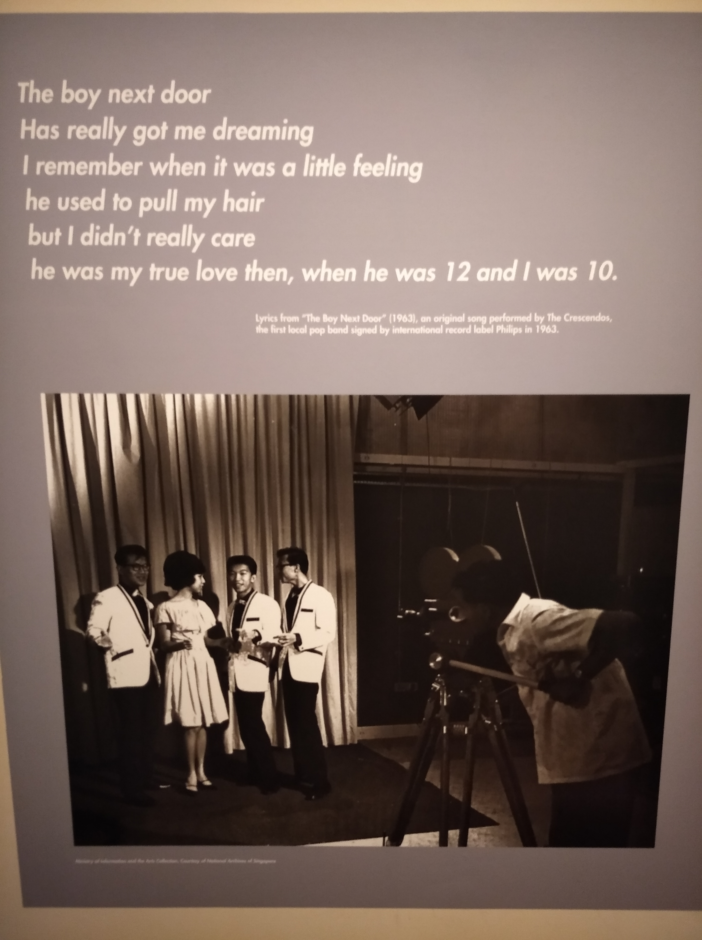
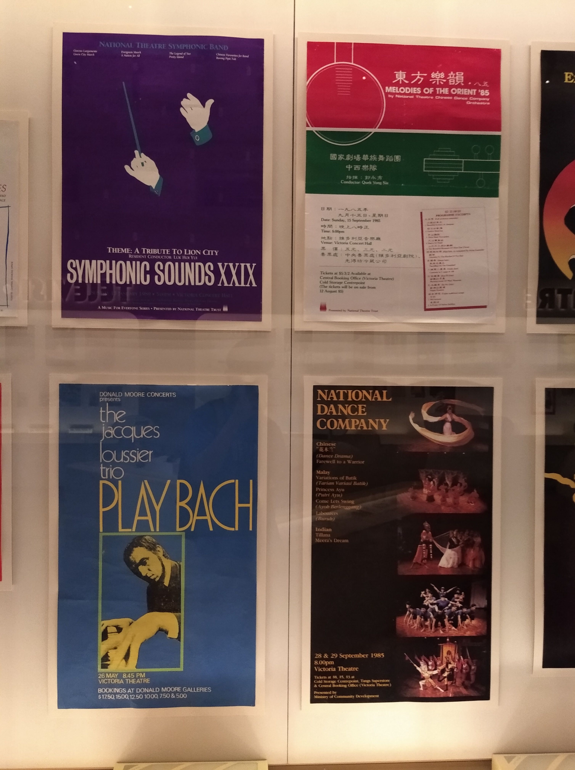
Firstly, this exhibition neglects to tell us how much these cultural artefacts reflected societal attitudes at that time. To what extent did people back then watch English theatrical plays and agree with their messages?
If these cultural productions were not relevant to people’s lived reality back then, what more now?
Secondly, this “legacy” of cultural production has largely disappeared from our society today. With globalisation, Singaporeans today predominantly consume foreign cultural imports. At the same time, modern Singaporean lifestyles are largely homogeneous with those of urban dwellers around the world. There is little in our everyday life (that is meaningfully different from other societies) to wax lyrical about. If we can neither claim “ownership” of the cultural products themselves, nor the process of cultural production, what place does our art scene have in our heritage?

Slide 8
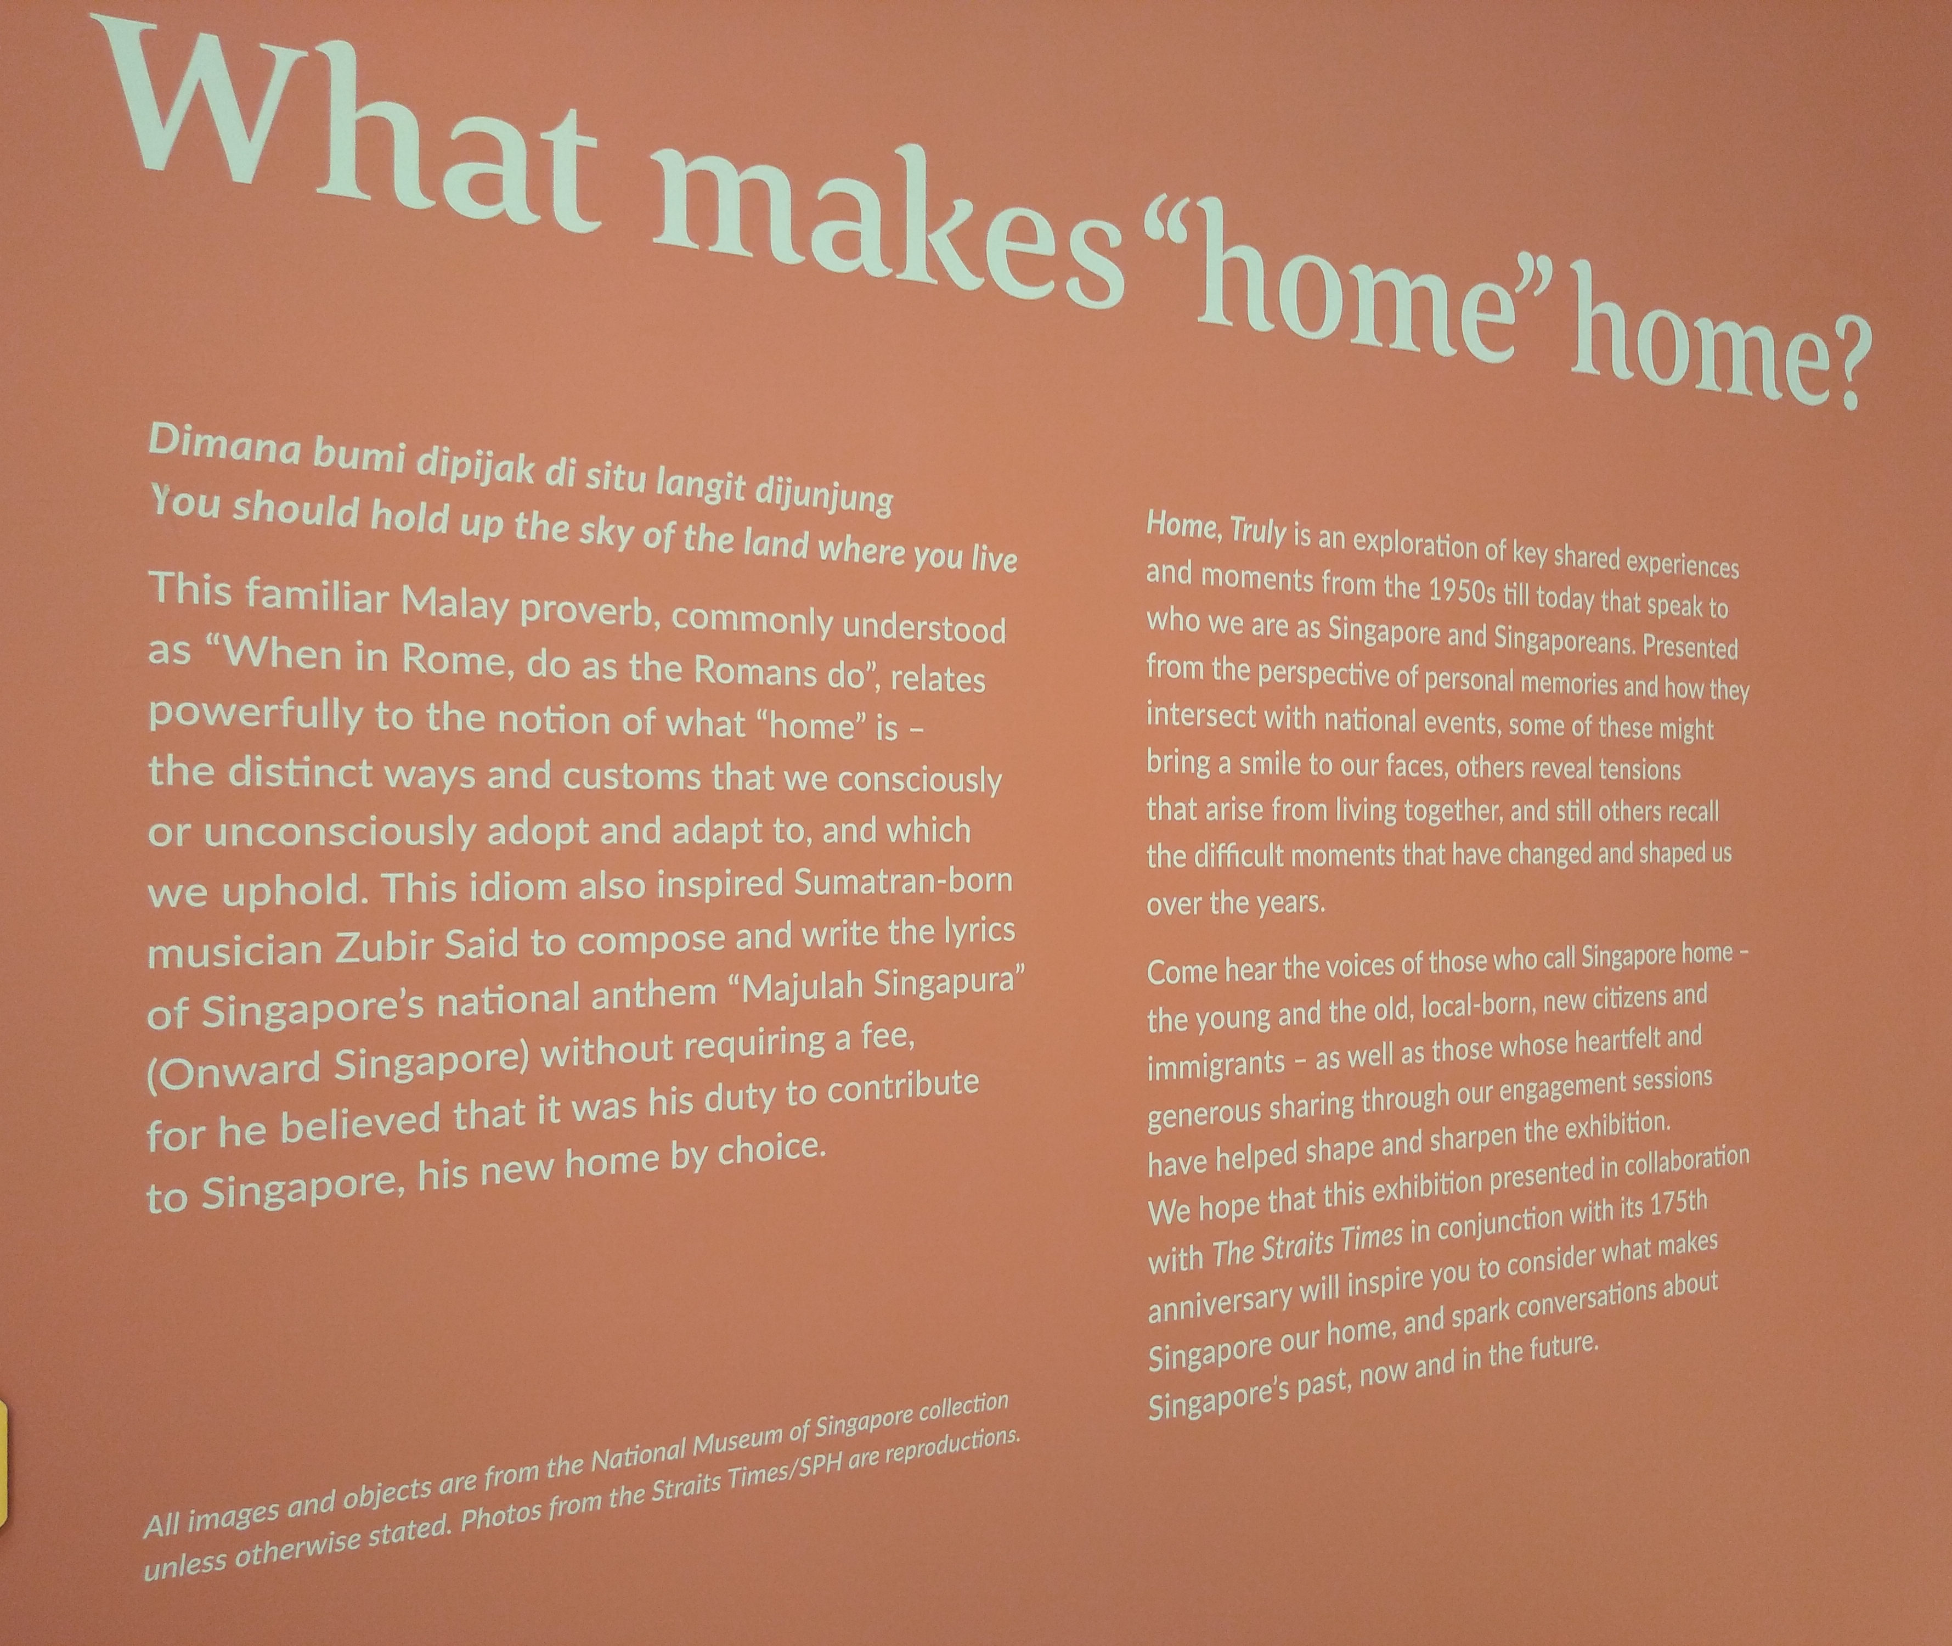
Final Destination: Home, Truly
3
Exhibition 3
If what we’ve seen thus far is not heritage, what is heritage supposed to look like? Lily Kong gives us two criteria:
Heritage must be made up of collective memories.
People must derive a shared understanding and sense of belonging from these collective memories (Kong 1999).
This final exhibition is an eye-opener about how to connect people’s personal memories into a collective memory that provides a shared understanding about what it means to be Singaporean.
Before entering, the exhibition asks the viewer to register an RFID-tagged pen with your name so that it can record your interactions with the exhibits (if you want) and send them to you as a keepsake.

Slide 9
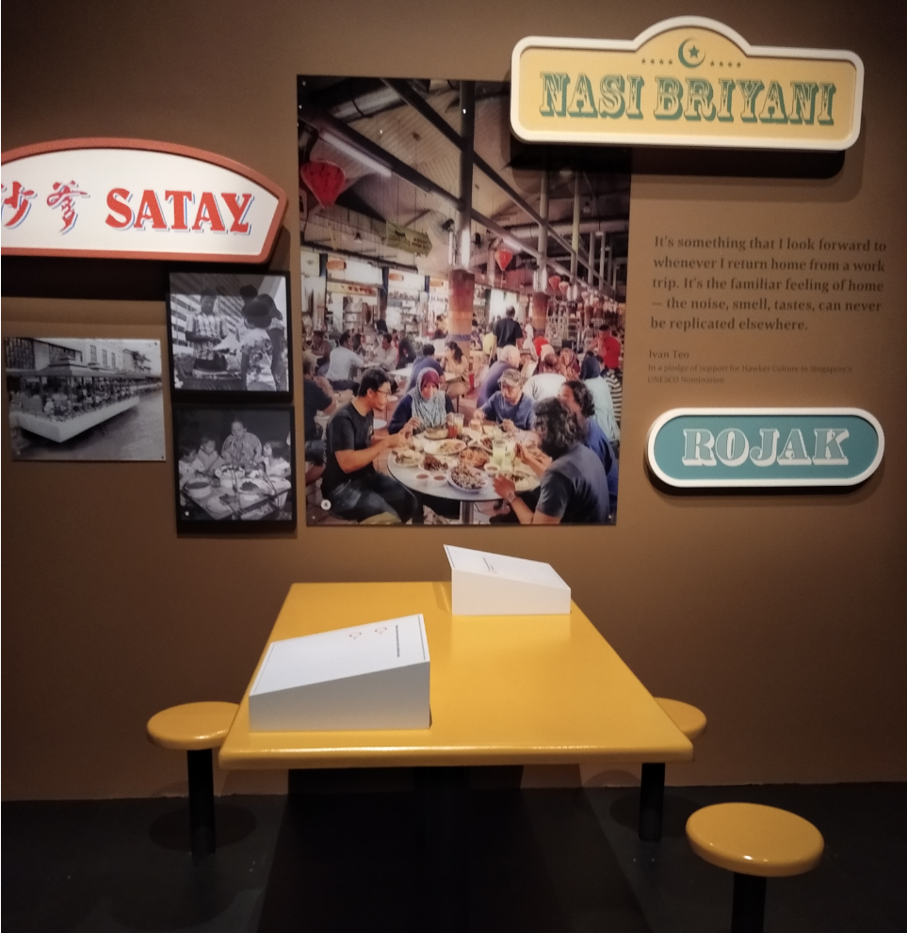
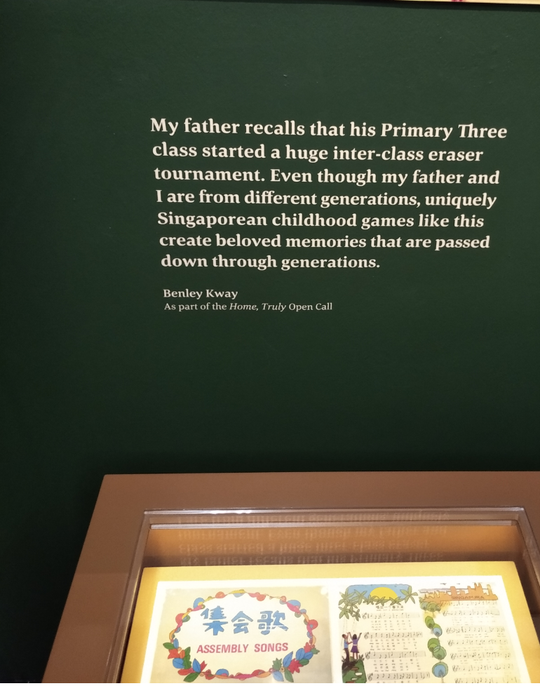
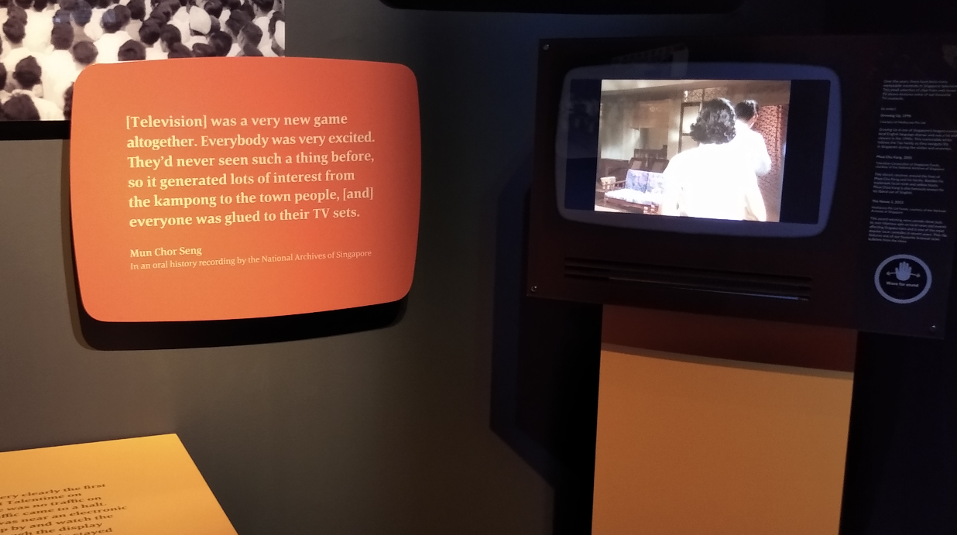
Inside, each exhibit focuses on a specific experience that Singaporeans would share across generations, such as voting, eating at hawker centres, playing childhood games in school, or watching local dramas on television. There is very little on display because the exhibit wants the viewer to colour in the blanks with his/her own experiences.
Each exhibit shows how people in the past did something which Singaporeans still do today. For example, in the middle, a Singaporean recalls playing the same games as his father in school.
This creates a strong sense of continuity which Hobsbawm emphasises is important for institutionalising people (Hobsbawm and Ranger 1983).

Slide 10
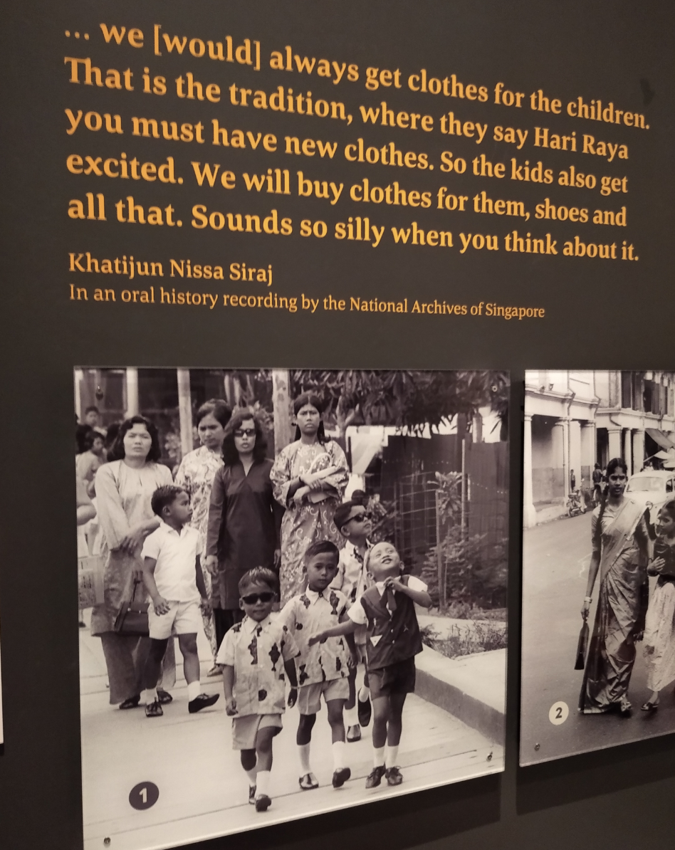
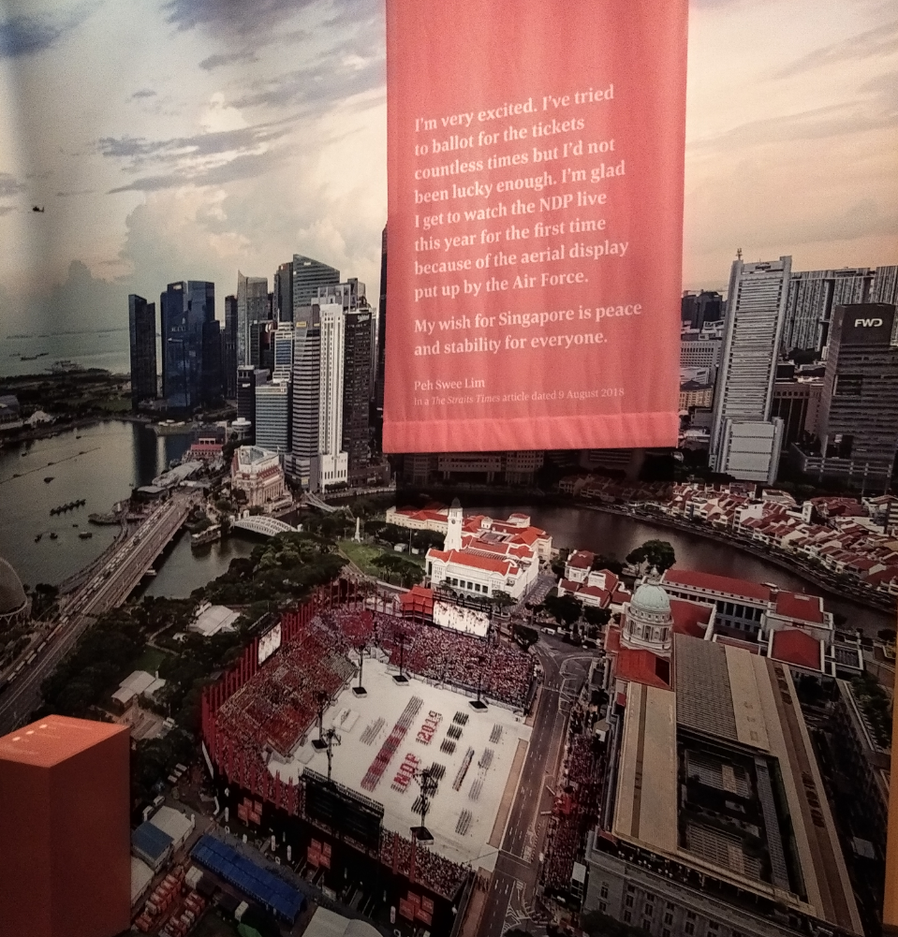
Other activities that Singaporeans can identify with: New Year Celebrations, and the National Day Parade.

Slide 11
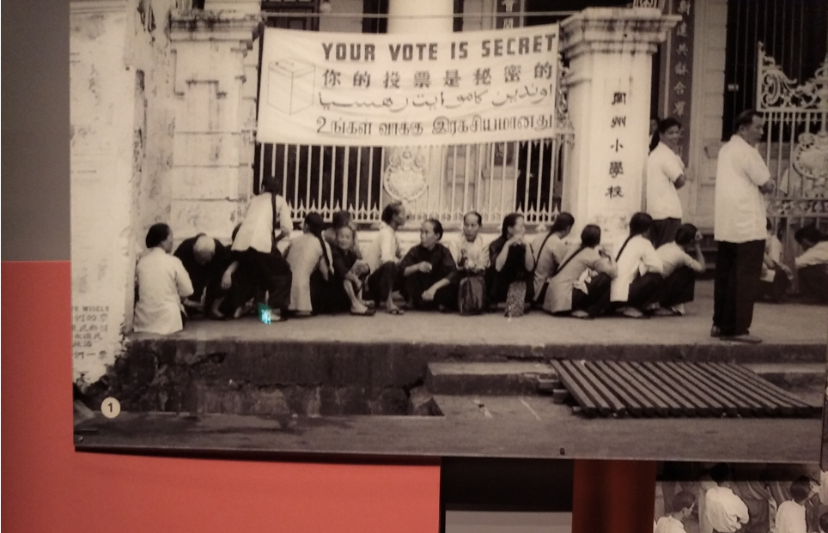
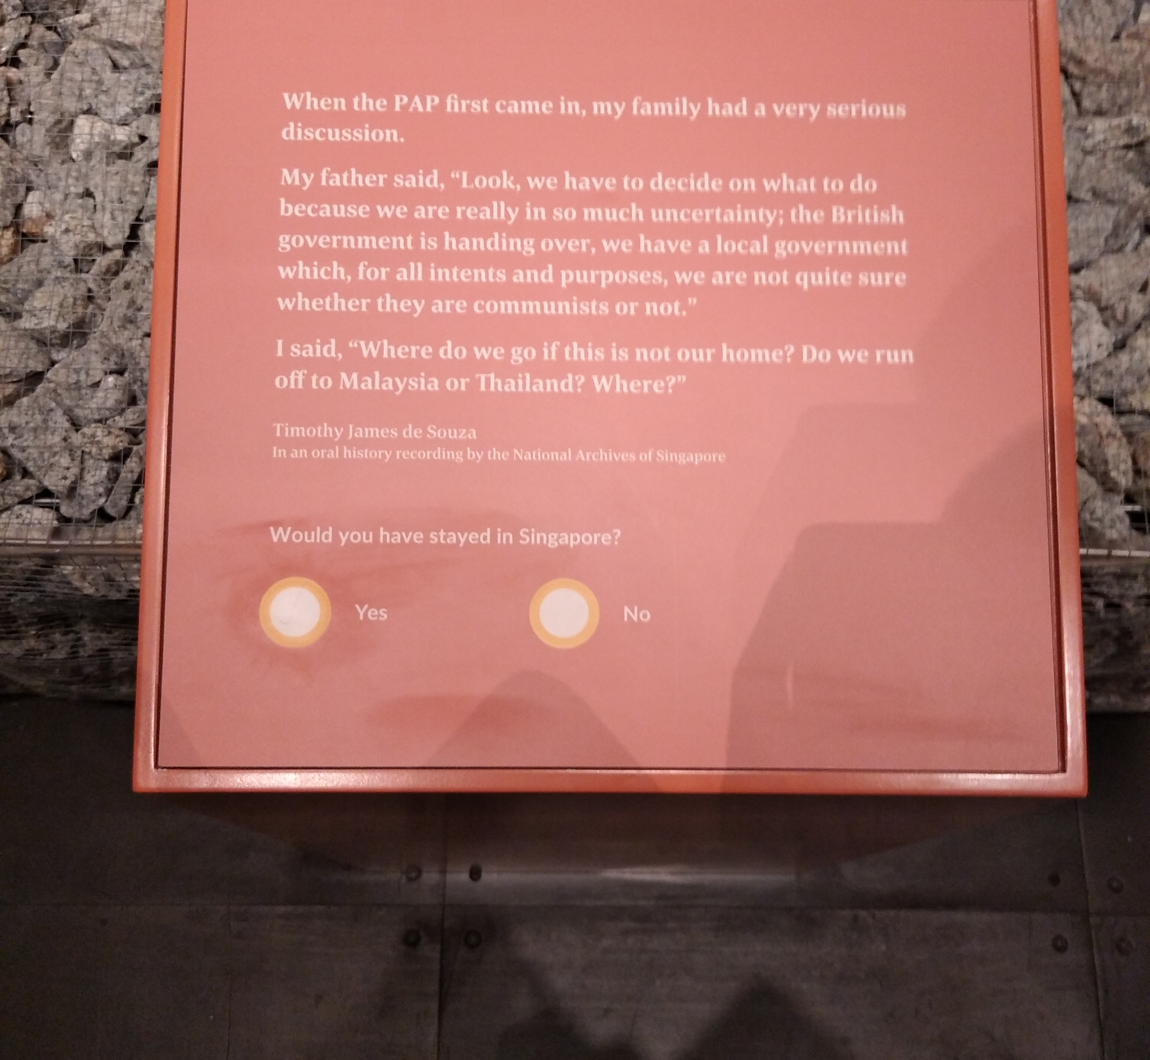
Accompanying each exhibit is a question-and-answer box that asks you a question such as whether you grew up watching local television shows, which you can answer by tapping the RFID tag on the options. By reflecting on your experiences, you realise the myriad of ways in which your life intersects with the national narrative.
By showing how Singaporeans in the past went through similar experiences as Singaporeans today, these ordinary experiences are elevated into cultural rites-of-passage. Meaning is added to what were previously mundane aspects of a Singaporean’s existence. Now, the viewer has a “myth of origin and continuance” (Lowenthal 1997) that makes these experiences feel like identity markers.

Slide 12
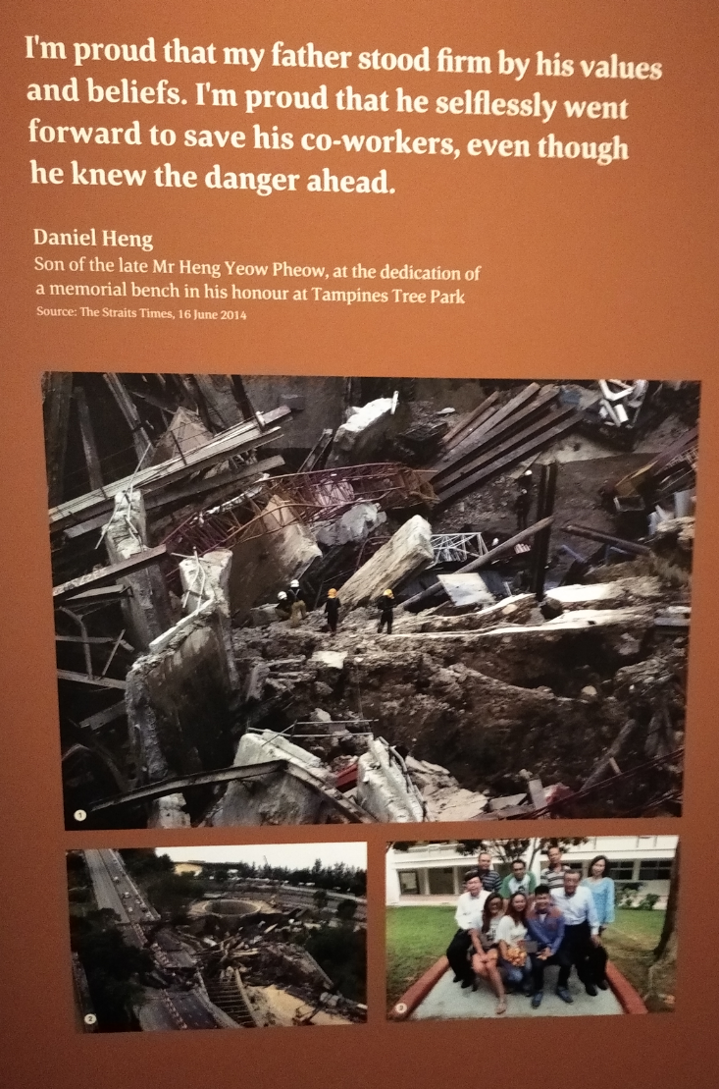
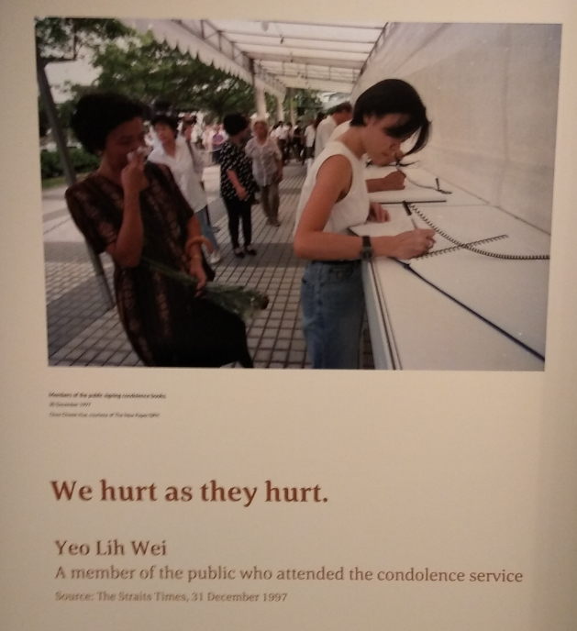
One thing that this exhibition also gets right is that heritage isn’t always made of happy memories. There are exhibits about the SARS outbreak, the SilkAir plane crash of 1997, the Nicoll Highway collapse, and the current Covid-19 pandemic. These exhibits add gravity to the past and remind Singaporeans that part of our heritage is the spirit of nobility demonstrated by our forebearers, which shines the brightest in dark times.

Slide 13
End of tour
Farewell, my friend
Of course, there are things in our past that the Home, Truly leaves out of the narrative. But as Lowenthal says, “the worth of heritage is…gauged not by critical tests but by current potency” (Lowenthal 1997). If a Singaporean leaves the exhibition feeling empowered by the similar experiences of his/her forebearers and is better prepared to navigate the future as a Singaporean, this exhibition has done its job.
The worth of heritage is gauged not by critical tests but by current potency

Slide 14
Back cover
References
Anderson, Benedict. 1983. Imagined Communities.
Fisher, Max. 2018. “Israel Picks Identity Over Democracy. More Nations May Follow.” The New York Times, 22 July.
Hobsbawm, Eric, and Terence Ranger. 1983. The Invention of Tradition.
Kong, Lily. 1999. “The invention of heritage: popular music in Singapore.” Asian Studies Review 1-25.
Lowenthal, David. 1997. The Heritage Crusade and the Spoils of History. New York: Cambridge University Press.

